Slide 1


DocTech
Our medical website

Slide 2

DocTech
Keep working on your health.
About our DocTech
A medical website
Our medical website
The system concentrates on the options that the user choose. The goal is to discover any early warning signs or problems that the user may be having. After Doctech has gathered enough keywords from the initial messages, it begins asking the user questions and attempting to narrow down a few ailments that the user may be experiencing. After the Doctech has narrowed down the probable conditions that the user could be suffering from, it now assigns a ranking to those disorders. When the list of possible diseases, the Doctech starts interrogating the user about how the user is feeling. Once it has gathered enough information, it determines the most likely disease that the user is suffering from.

Slide 3

Customer Service
Patient Engagement
Keep working on your health.
About our DocTech
Mental Health
Claims and Billing
A medical website
The system concentrates on the options that the user choose. The goal is to discover any early warning signs or problems that the user may be having. After Doctech has gathered enough keywords from the initial messages, it begins asking the user questions and attempting to narrow down a few ailments that the user may be experiencing. After the Doctech has narrowed down the probable conditions that the user could be suffering from, it now assigns a ranking to those disorders. When the list of possible diseases, the Doctech starts interrogating the user about how the user is feeling. Once it has gathered enough information, it determines the most likely disease that the user is suffering from.

Slide 4


Keep working on your health.
Claims and Billing
About our DocTech
A medical website
SCOPE
Economic Assesment
Patient Engagement
The development of this system does not require investing money. Health care interventions are increasingly being delivered through digital technologies, offering major opportunities for delivering more health gains from scarce health care resources.
Customer Service
Mental Health
All the sources and information can be accessed online. Within the present scope form, economy feasibility is not warranted for this system.
The system concentrates on the options that the user choose. The goal is to discover any early warning signs or problems that the user may be having. After Doctech has gathered enough keywords from the initial messages, it begins asking the user questions and attempting to narrow down a few ailments that the user may be experiencing. After the Doctech has narrowed down the probable conditions that the user could be suffering from, it now assigns a ranking to those disorders. When the list of possible diseases, the Doctech starts interrogating the user about how the user is feeling. Once it has gathered enough information, it determines the most likely disease that the user is suffering from.
Research / Treatment

Slide 5
Keep working on your health.
About our DocTech
A medical website
SCOPE
Economic Assesment
The development of this system does not require investing money. Health care interventions are increasingly being delivered through digital technologies, offering major opportunities for delivering more health gains from scarce health care resources.
Treatment
Claims and Billing
All the sources and information can be accessed online. Within the present scope form, economy feasibility is not warranted for this system.
The system concentrates on the options that the user choose. The goal is to discover any early warning signs or problems that the user may be having. After Doctech has gathered enough keywords from the initial messages, it begins asking the user questions and attempting to narrow down a few ailments that the user may be experiencing. After the Doctech has narrowed down the probable conditions that the user could be suffering from, it now assigns a ranking to those disorders. When the list of possible diseases, the Doctech starts interrogating the user about how the user is feeling. Once it has gathered enough information, it determines the most likely disease that the user is suffering from.
Patient Engagement
Mental Health
Customer Service/Administration with an AI Chatbot

Slide 6
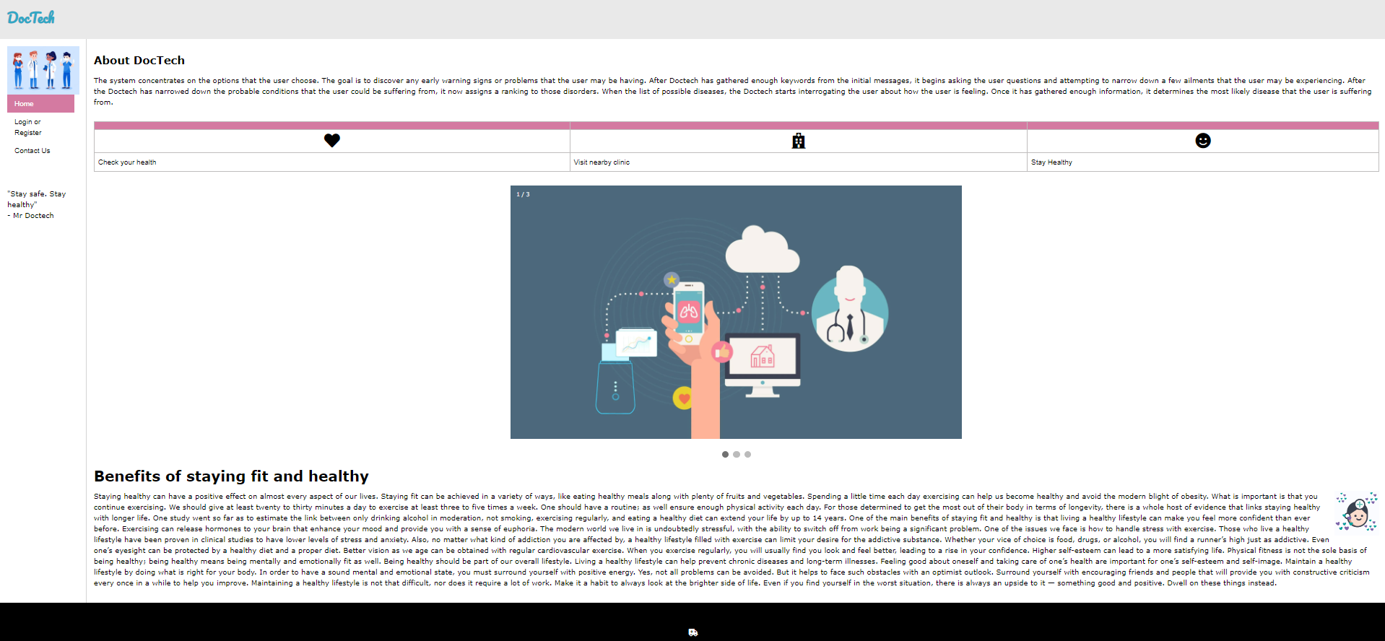
Keep working on your health.
Patient Engagement
SERVICES
About our DocTech
A medical website
Economic Assesment
Customer Service/Administration with an AI Chatbot
The development of this system does not require investing money. Health care interventions are increasingly being delivered through digital technologies, offering major opportunities for delivering more health gains from scarce health care resources.
Mental Health
Claims and Billing
The system concentrates on the options that the user choose. The goal is to discover any early warning signs or problems that the user may be having. After Doctech has gathered enough keywords from the initial messages, it begins asking the user questions and attempting to narrow down a few ailments that the user may be experiencing. After the Doctech has narrowed down the probable conditions that the user could be suffering from, it now assigns a ranking to those disorders. When the list of possible diseases, the Doctech starts interrogating the user about how the user is feeling. Once it has gathered enough information, it determines the most likely disease that the user is suffering from.
All the sources and information can be accessed online. Within the present scope form, economy feasibility is not warranted for this system.

Slide 7
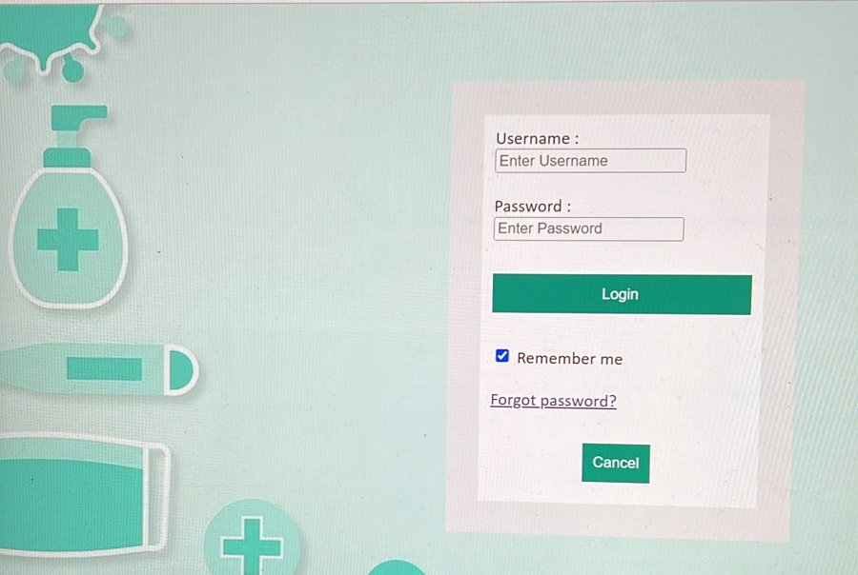
Keep working on your health.
Loginpage
Patient Engagement
SERVICES
The development of this system does not require investing money. Health care interventions are increasingly being delivered through digital technologies, offering major opportunities for delivering more health gains from scarce health care resources.
About our DocTech
A medical website
Customer Service/Administration with an AI Chatbot
Homepage
All the sources and information can be accessed online. Within the present scope form, economy feasibility is not warranted for this system.
Mental Health
Claims and Billing
The system concentrates on the options that the user choose. The goal is to discover any early warning signs or problems that the user may be having. After Doctech has gathered enough keywords from the initial messages, it begins asking the user questions and attempting to narrow down a few ailments that the user may be experiencing. After the Doctech has narrowed down the probable conditions that the user could be suffering from, it now assigns a ranking to those disorders. When the list of possible diseases, the Doctech starts interrogating the user about how the user is feeling. Once it has gathered enough information, it determines the most likely disease that the user is suffering from.

Slide 8
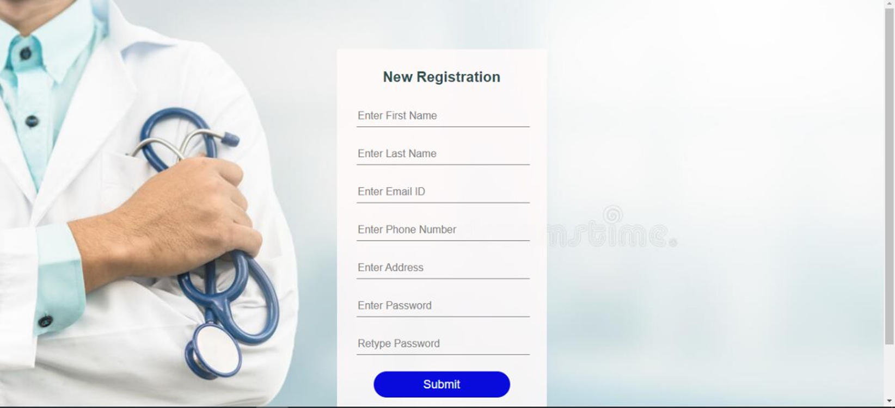
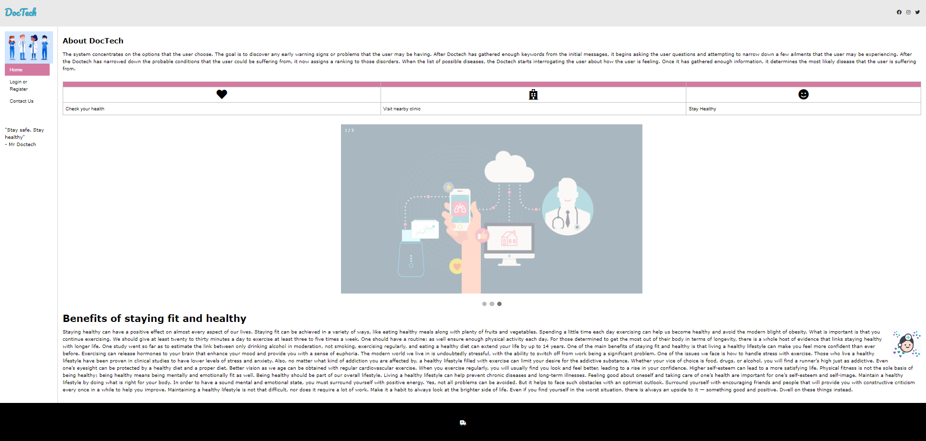
Register page
Keep working on your health.
Patient Engagement
SERVICES
The development of this system does not require investing money. Health care interventions are increasingly being delivered through digital technologies, offering major opportunities for delivering more health gains from scarce health care resources.
About our DocTech
A medical website
Customer Service/Administration with an AI Chatbot
Loginpage
All the sources and information can be accessed online. Within the present scope form, economy feasibility is not warranted for this system.
Mental Health
Claims and Billing
The system concentrates on the options that the user choose. The goal is to discover any early warning signs or problems that the user may be having. After Doctech has gathered enough keywords from the initial messages, it begins asking the user questions and attempting to narrow down a few ailments that the user may be experiencing. After the Doctech has narrowed down the probable conditions that the user could be suffering from, it now assigns a ranking to those disorders. When the list of possible diseases, the Doctech starts interrogating the user about how the user is feeling. Once it has gathered enough information, it determines the most likely disease that the user is suffering from.

Slide 9
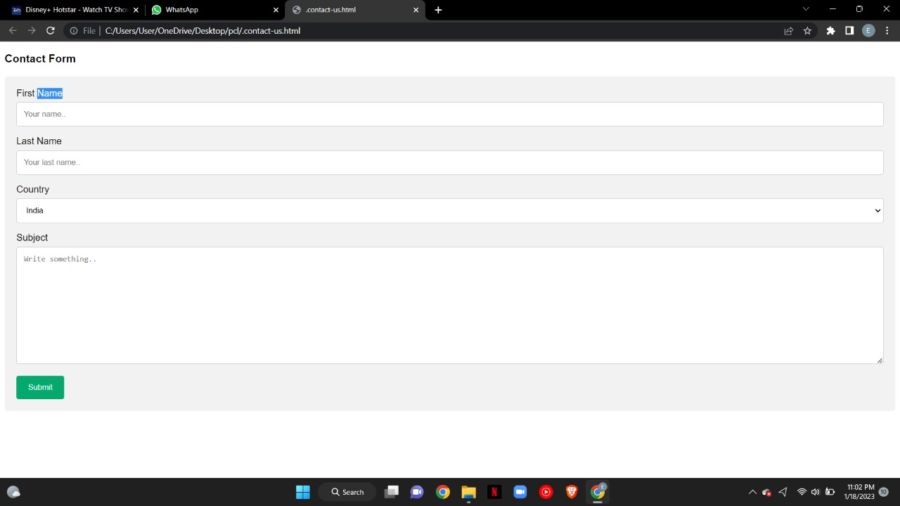

Contact us page
Keep working on your health.
Patient Engagement
SERVICES
The development of this system does not require investing money. Health care interventions are increasingly being delivered through digital technologies, offering major opportunities for delivering more health gains from scarce health care resources.
About our DocTech
A medical website
Customer Service/Administration with an AI Chatbot
Register page
All the sources and information can be accessed online. Within the present scope form, economy feasibility is not warranted for this system.
Mental Health
Claims and Billing
The system concentrates on the options that the user choose. The goal is to discover any early warning signs or problems that the user may be having. After Doctech has gathered enough keywords from the initial messages, it begins asking the user questions and attempting to narrow down a few ailments that the user may be experiencing. After the Doctech has narrowed down the probable conditions that the user could be suffering from, it now assigns a ranking to those disorders. When the list of possible diseases, the Doctech starts interrogating the user about how the user is feeling. Once it has gathered enough information, it determines the most likely disease that the user is suffering from.

Slide 10
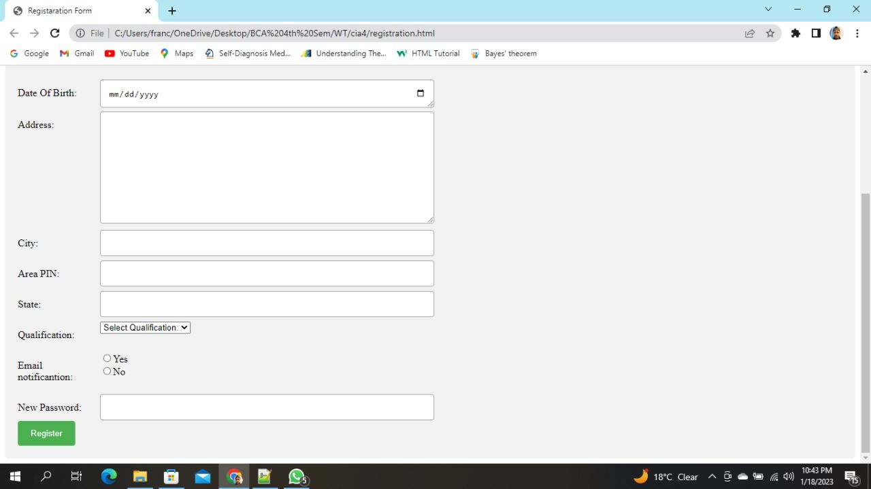
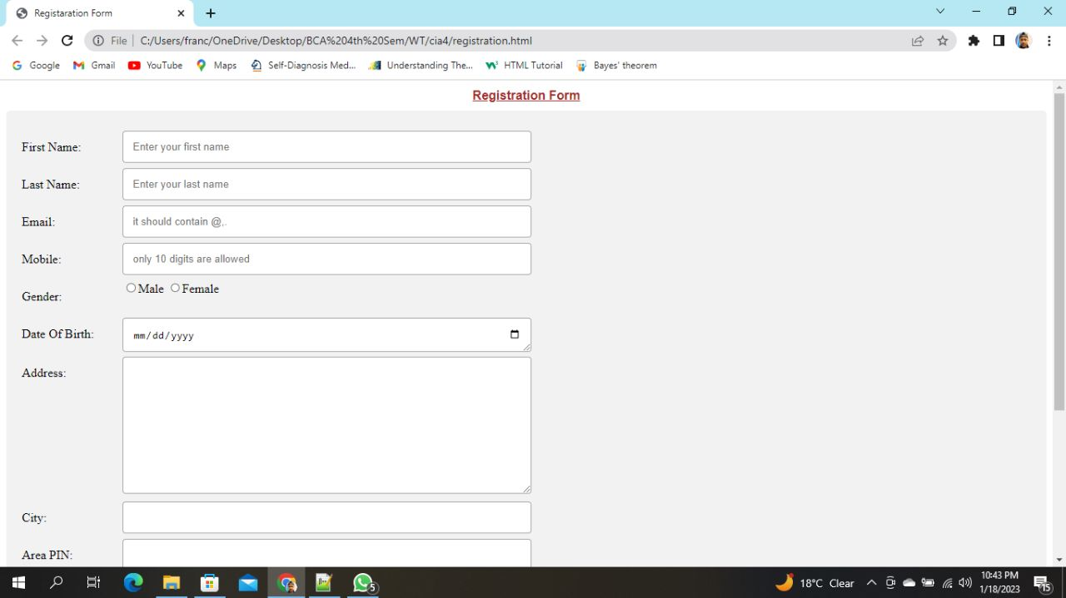
Members
Keep working on your health.
Patient Engagement
SERVICES
The development of this system does not require investing money. Health care interventions are increasingly being delivered through digital technologies, offering major opportunities for delivering more health gains from scarce health care resources.
About our DocTech
A medical website
Customer Service/Administration with an AI Chatbot
Contact us page
All the sources and information can be accessed online. Within the present scope form, economy feasibility is not warranted for this system.
Mental Health
Bibidha
Claims and Billing
Diya
Eva
The system concentrates on the options that the user choose. The goal is to discover any early warning signs or problems that the user may be having. After Doctech has gathered enough keywords from the initial messages, it begins asking the user questions and attempting to narrow down a few ailments that the user may be experiencing. After the Doctech has narrowed down the probable conditions that the user could be suffering from, it now assigns a ranking to those disorders. When the list of possible diseases, the Doctech starts interrogating the user about how the user is feeling. Once it has gathered enough information, it determines the most likely disease that the user is suffering from.
Frank

Slide 11
Contact us page
THANK YOU
Keep working on your health.
Patient Engagement
SERVICES
The development of this system does not require investing money. Health care interventions are increasingly being delivered through digital technologies, offering major opportunities for delivering more health gains from scarce health care resources.
Customer Service/Administration with an AI Chatbot
our DocTech
All the sources and information can be accessed online. Within the present scope form, economy feasibility is not warranted for this system.
A medical website
Members
Mental Health
Claims and Billing
Bibidha
The system concentrates on the options that the user choose. The goal is to discover any early warning signs or problems that the user may be having. After Doctech has gathered enough keywords from the initial messages, it begins asking the user questions and attempting to narrow down a few ailments that the user may be experiencing. After the Doctech has narrowed down the probable conditions that the user could be suffering from, it now assigns a ranking to those disorders. When the list of possible diseases, the Doctech starts interrogating the user about how the user is feeling. Once it has gathered enough information, it determines the most likely disease that the user is suffering from.
Diya
Eva
Frank

Slide 12
Contact us page
Bibidha
Keep working on your health.
Diya
Patient Engagement
Members
SERVICES
The development of this system does not require investing money. Health care interventions are increasingly being delivered through digital technologies, offering major opportunities for delivering more health gains from scarce health care resources.
Customer Service/Administration with an AI Chatbot
our DocTech
All the sources and information can be accessed online. Within the present scope form, economy feasibility is not warranted for this system.
A medical website
Mental Health
THANK YOU
Claims and Billing
The system concentrates on the options that the user choose. The goal is to discover any early warning signs or problems that the user may be having. After Doctech has gathered enough keywords from the initial messages, it begins asking the user questions and attempting to narrow down a few ailments that the user may be experiencing. After the Doctech has narrowed down the probable conditions that the user could be suffering from, it now assigns a ranking to those disorders. When the list of possible diseases, the Doctech starts interrogating the user about how the user is feeling. Once it has gathered enough information, it determines the most likely disease that the user is suffering from.
Eva
Frank

